Slide 1
Copyright © 2007 MES-English.com

Slide 2
Zero / oh

Slide 3
one

Slide 4
two

Slide 5
three

Slide 6
four

Slide 7
five

Slide 8
six

Slide 9
seven

Slide 10
eight

Slide 11
nine

Slide 12
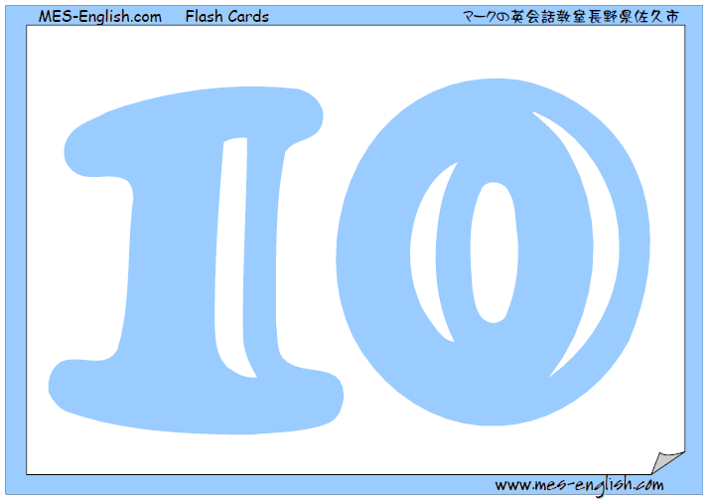
ten

